Slide 1
IRG-AVQA (Intersector Rapporteur Group Audiovisual Quality Assessment) Agenda
March 9-13, 2020
Seattle, USA

Slide 2
The IRG-AVQA studies topics related to video and audiovisual quality assessment among ITU-R SG6 and ITU-T SG12. The IRG-AVQA aims to:
coord​inate the progress of specific topics of mutual interest restricted to the area of video and audiovisual quality assessment, both subjective and objective;
identify potential work items that may be progressed as joint text Recommendations;
benefit from colocation with the meetings of the Video Quality Experts Group (VQEG)​​ where video/audiovisual quality experts meet and execute technical work;
encourage collaboration between ITU-T SG12 and ITU-R SG6 on work items unique to each study group.

Slide 3
The IRG-AVQA allows rapporteurs to:
exchange information faster, using email and joint meetings;
seek participation from a broader range of ITU members;
invite input from non-member experts (e.g., from academia);
keep people informed at the early stage of work;
set up a joint edit session on a Recommendation;
socialize work items that approach maturity;
Participants who can contribute technology proposals are invited and encouraged to join the group.
https://www.itu.int/en/irg/avqa/Pages/default.aspx

Slide 4
Co-Chairs
Chulh​ee Lee (Korea, Rep of)
Quan Huynh-Thu (Australia)
Jens Berger (Germany)

Slide 5
Progress and recent works of ITU-R WP6C
Revision of BT.500
HDR related items & topics
Rapporteur Group (RG 24) on HDR-TV
Several Recommendations and Reports on HDR
Preliminary draft new Recommendation ITU-R BT.[MIL] - An objective measurement algorithm for monitoring and managing the brightness of high dynamic range television
Objective quality measurement methods for HDR TM methods

Slide 6
Progress and recent works of ITU-R WP6C
Revised BT.500-14: Scope
This Recommendation provides methodologies for the assessment of image quality including, general testing methods, the grading scales used during assessments and the viewing conditions recommended for carrying out assessments. The Recommendation consists of three parts.
Part 1 describes the overall requirements for carrying out subjected assessment of television images and guidance on the circumstances for the use of particular methodologies.
Part 2 describes the various recommended assessment methodologies that can be used when performing subjective image quality assessments.
Part 3 describes methodologies specific to image formats and applications based on the specifications given in Parts 1 and 2.

Slide 7
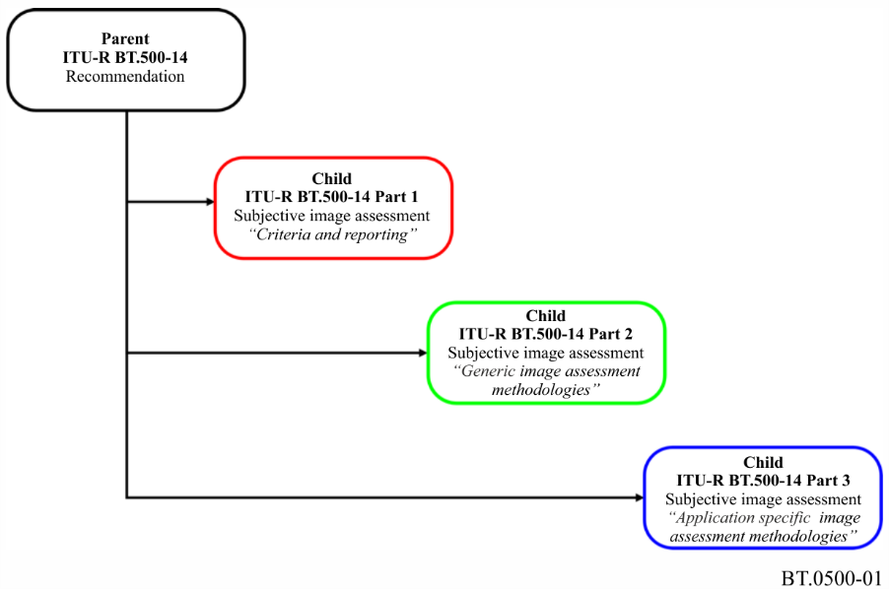
Progress and recent works of ITU-R WP6C
Revised BT.500-14

Slide 8
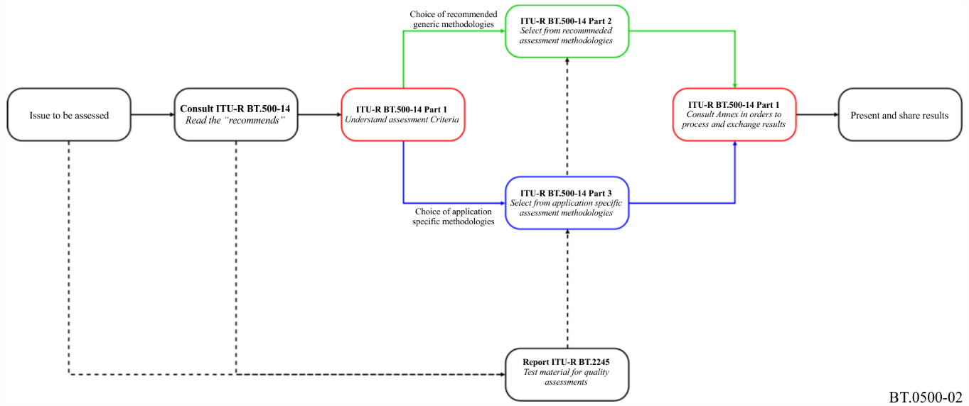
Progress and recent works of ITU-R WP6C
Revised BT.500-14

Slide 9
Progress and recent works of ITU-R WP6C
Revised BT.500-14: Annex
Annex 1 Subjective assessment of standard definition digital television (SDTV) systems based on Recommendation ITU-R BT.1129: Subjective assessment of standard definition digital television (SDTV) systems
Annex 2 Subjective assessment of the image quality of high-definition television (HDTV) systems based on Recommendation ITU-R BT.710: Subjective assessment methods for image quality in high-definition television
Annex 3 Subjective assessment of the quality of alphanumeric and graphic pictures in Teletext and similar services based on Recommendation ITU-R BT.812: Subjective assessment of the quality of alphanumeric and graphic pictures in Teletext and similar services
Annex 4 Subjective assessment of the picture quality of multi-programme services based on Recommendation ITU-R BT.1382: Assessment of the picture quality of multi- programme services
Annex 5 Expert viewing of the image quality of systems for the digital display of large screen digital imagery in theatres based on Recommendation ITU-R BT.1663: Expert viewing methods to assess the quality of systems for the digital display of large screen digital imagery in theatres
Annex 6 Subjective assessment of the image quality of multimedia applications based on Recommendation ITU-R BT.1788: Methodology for the subjective assessment of video quality in multimedia applications
Annex 7 Subjective assessment of stereoscopic 3DTV systems based on Recommendation ITU R BT.2021: Subjective methods for assessment of stereoscopic 3DTV systems

Slide 10
Progress and recent work items of ITU-T SG12
Successful completion of P.NATS Phase II (VQEG AVHD)
Progress of AR/VR

Slide 11
Some work items of ITU-T SG12 Question 9 (Rapporteur: Jens Berger)
P.AMD: Perceptual approaches for multi-dimensional analysis
P.SAMS: Single-ended perceptual approaches for multi-dimensional analysis
P.ONRA: Perceptual objective noise reduction

Slide 12
Some work items of ITU-T SG12 Question 13 (Rapporteurs: Kazuhisa Yamagishi, Rachel Huang)
G.QoE-AR: QoE factors of augmented reality (AR) services
G.QoE-VR: Influencing Factors on Quality of Experience (QoE) for Virtual Reality Services
P.360-VR: Subjective test methodologies for 360 degree video on HMD

Slide 13
Some work items of ITU-T SG12 Question 14 (Rapporteurs: Jörgen Gustafsson, Alexander Raake)
P.NATS Phase II
P.ENATS: Methods for quality evaluation of audiovisual streams in case of packet-layer encryption
P.NAMS-ph2: Parametric Non-intrusive Bitstream Assessment for High Efficiency Video Coding (HEVC) and 4K Media Streaming Quality over UDP

Slide 14
Some work items of ITU-T SG12 Question 19 (Rapporteurs: Chulhee Lee, Quan Huynh-Thu)
J.noref: Perceptual video quality measurement techniques for digital cable television in the absence of a reference
J.343rev: Hybrid perceptual/bitstream models for objective video quality measurements
J.op-tr: Methods for Optimizing Bitrates and Transmission Resolution by Considering Display Characteristics and Available Bandwidth
P.910rev: Subjective video quality assessment methods for multimedia applications
P.913ref: Methods for the subjective assessment of video quality, audio quality and audiovisual quality of Internet video and distribution quality television in any environment

Slide 15
THE END

